Slide 1
Apostolos
Papatheodrou
Micro-Project
Aspect Based Sentiment Analysis

Slide 2

Presentation Structure
Definition of the problem
Aspect Based SA
LCF-ATEPC Model
Methodology
Datasets & Experiments
Results & Conclusions
Summary

Slide 3

What is this project about?
In this Project we try to answer:
What is Sentiment analysis?
What do you mean by Aspect Based Sentiment Analysis?
How is it work and why is it important?
How can we solve the problem?

Slide 4





The problem
Sentiment Analysis or Opinion Mining
An automated process capable of understanding the feelings or opinions that underlie a text or document
Different types of SA:
Text Polarity Classification
“Albert Einstein was born in Germany in 1879.”
“I love this movie! It's sweet, but with satirical humor. The dialogs are great and …”

Slide 5
The problem
Sentiment Analysis or Opinion Mining
An automated process capable of understanding the feelings or opinions that underlie a text or document
Different types of SA:
Text Polarity Classification
Opinion Role Extraction
Opinion Holder (OH): Entities expressing an opinion
Opinion Target (OT): Entities about the affect is felt
Input | Output
The coffee was ok and the waitress was polite. But the music was too nosy and ... | Cafe: ok Waitress: polite Music: nosy
Target oriented

Slide 6
The problem
Sentiment Analysis or Opinion Mining
An automated process capable of understanding the feelings or opinions that underlie a text or document
Different types of SA:
Text Polarity Classification
Opinion Role Extraction
Aspect/Feature Based Sentiment Analysis
Determine the sentiment about a specific aspect/entity
Different features generate different sentiment
“The actors were outstanding but the plot was terrible.”

Slide 7
The problem
Sentiment Analysis or Opinion Mining
An automated process capable of understanding the feelings or opinions that underlie a text or document
Different types of SA:
Text Polarity Classification
Opinion Role Extraction
Aspect/Feature Based Sentiment Analysis
Determine the sentiment about a specific aspect/entity
Different features generate different sentiment
“The[O -1] actors [B-ASP 2] were[O -1] outstanding[O -1]
but[O -1] the[O -1] plot [B-ASP -1] was[O -1] terrible[O -1].”
IOB format

Slide 8
The problem
Sentiment Analysis or Opinion Mining
An automated process capable of understanding the feelings or opinions that underlie a text or document
Different types of SA:
Text Polarity Classification
Opinion Role Extraction
Aspect/Feature Based Sentiment Analysis
Aspect/Feature Based Sentiment Analysis
...

Slide 9
Aspect Based Sentiment Analysis
ATE: Aspect Term Extraction
ATE and APC are independent tasks
Not overall sentiment for the whole document (aspect level polarities)
Dual labeling with IOB format for ATE
Loss = LossAte + LossApc
Extracts potential aspects
ABSA
APC: Aspect Polarity Classification
Predicts the aspects’ polarities

Slide 10
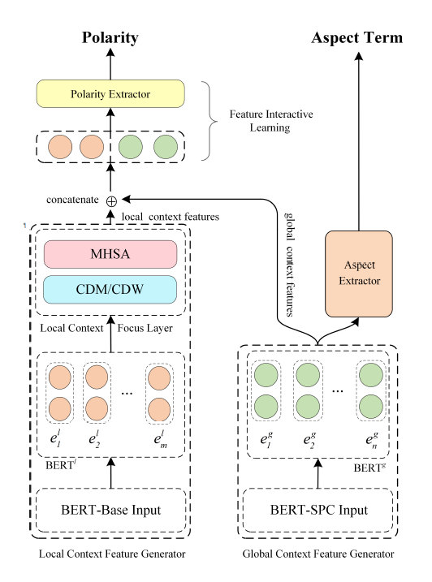
ABSA: LCF-ATEPC
ATE: Aspect Term Extraction
Extracts potential aspects
LCF-ATEPC
ABSA
APC: Aspect Polarity Classification
Predicts the aspects’ polarities
Local Context Focus (LCF):
Local Context Feature Generator (LCFG)
Global Context Feature Generator (GCFG)
GCFG:
The part of the model which is charged with the ATE task.
Exploits global (from all sentence) information
Uses Bert layer and MHSA mechanism

Slide 11
ABSA: LCF-ATEPC
ATE: Aspect Term Extraction
Extracts potential aspects
LCF-ATEPC
ABSA
APC: Aspect Polarity Classification
Predicts the aspects’ polarities
Local Context Focus (LCF):
Local Context Feature Generator (LCFG)
Global Context Feature Generator (GCFG)
LCFG: Focus on the local context of a specific aspect
Uses Semantic Relative Distance (SRD)
Formula: SRD = | i - Pa| - |m/2|
SRD
They are often crowded[B-ASP 0] on the weekends.

Slide 12
ABSA: LCF-ATEPC
ATE: Aspect Term Extraction
Extracts potential aspects
LCF-ATEPC
ABSA
APC: Aspect Polarity Classification
Predicts the aspects’ polarities
Local Context Focus (LCF):
Local Context Feature Generator (LCFG)
Global Context Feature Generator (GCFG)
LCFG: Focus on the local context of a specific aspect
Uses Semantic Relative Distance (SRD)
Formula: SRD = | i - Pa| - |m/2|
SRD
They are often crowded[B-ASP 0] on the weekends.

Slide 13
LCF-ATEPC: SRD
ATE: Aspect Term Extraction
Extracts potential aspects
LCF-ATEPC
ABSA
APC: Aspect Polarity Classification
Predicts the aspects’ polarities
Local Context Focus (LCF):
Local Context Feature Generator (LCFG)
Global Context Feature Generator (GCFG)
LCFG: Focus on the local context of a specific aspect
Uses Semantic Relative Distance (SRD)
SRD(crowded, are) = 2
SRD
They are often crowded[B-ASP 0] on the weekends.

Slide 14
LCF-ATEPC: SRD
ATE: Aspect Term Extraction
Extracts potential aspects
LCF-ATEPC
ABSA
APC: Aspect Polarity Classification
Predicts the aspects’ polarities
Local Context Focus (LCF):
Local Context Feature Generator (LCFG)
Global Context Feature Generator (GCFG)
LCFG: Focus on the local context of a specific aspect
Uses Semantic Relative Distance (SRD)
SRD(crowded, weekend)=3
SRD
They are often crowded[B-ASP 0] on the weekends.

Slide 15
LCF-ATEPC: CDM
ATE: Aspect Term Extraction
Extracts potential aspects
LCF-ATEPC
ABSA
APC: Aspect Polarity Classification
Predicts the aspects’ polarities
Local Context Focus (LCF):
Local Context Feature Generator (LCFG)
Global Context Feature Generator (GCFG)
LCFG: Focus on the local context of a specific aspect
Uses Semantic Relative Distance (SRD)
Local Focus with: Context Dynamic Masking (CDM) and Context Dynamic Weighting (CDW)
IF SRD = 2
CDM
They are often crowded[B-ASP 0] on the weekends.

Slide 16
LCF-ATEPC: CDM
ATE: Aspect Term Extraction
Extracts potential aspects
LCF-ATEPC
ABSA
APC: Aspect Polarity Classification
Predicts the aspects’ polarities
Local Context Focus (LCF):
Local Context Feature Generator (LCFG)
Global Context Feature Generator (GCFG)
LCFG: Focus on the local context of a specific aspect
Uses Semantic Relative Distance (SRD)
Local Focus with: Context Dynamic Masking (CDM) and Context Dynamic Weighting (CDW)
IF SRD = 2
CDM
are often crowded[B-ASP 0] on the

Slide 17
LCF-ATEPC: CDW
ATE: Aspect Term Extraction
Extracts potential aspects
LCF-ATEPC
ABSA
APC: Aspect Polarity Classification
Predicts the aspects’ polarities
Local Context Focus (LCF):
Local Context Feature Generator (LCFG)
Global Context Feature Generator (GCFG)
LCFG: Focus on the local context of a specific aspect
Uses Semantic Relative Distance (SRD)
Local Focus with: Context Dynamic Masking (CDM) and Context Dynamic Weighting (CDW)
IF SRD = 2
CDW
They are often crowded[B-ASP 0] on the weekends.

Slide 18
LCF-ATEPC: FIL
ATE: Aspect Term Extraction
Extracts potential aspects
LCF-ATEPC
ABSA
APC: Aspect Polarity Classification
Predicts the aspects’ polarities
Local Context Focus (LCF):
Local Context Feature Generator (LCFG)
Global Context Feature Generator (GCFG)
Feature Interactive Learning (FIL)
FIL:
Utilises both LCFG and GCFG
Local and Global features are used together to produce aspects’ polarity (APC task)

Slide 19

Challenges
How does the model performs real data?
How important are the different Components ?
Can we use it in Greek language?
What else can we do?
EXPERIMENTS

Slide 20
Challenges
How does the model performs real data?
How important are the different Components ?
Can we use it in Greek language?
What else can we do?
Solution: Experiments on:
Different ABSA datasets
Ablation study on LCF-ATEPC
Examine model’s predefined parameters
SRD distance, bert-models, Loss, etc.
EXPERIMENTS

Slide 21
Challenges & Datasets
How does the model performs real data?
How important are the different Components ?
Can we use it in Greek language?
What else can we do?
Solution: Experiments on:
Different ABSA datasets
Ablation study on LCF-ATEPC
Examine model’s predefined parameters
SRD distance, bert-models, Loss, etc.
Datasets
Five different datasets:
Restaurants, Twitter [Eng]
Camera [Chi]
Mixed [Eng, Chi]
MultiLingual [Eng, Chi, Gr]
180+ greek records
Training instance
Biggest O -1 complaint O -1 is O -1 Windows B-ASP 0 8 I-ASP 0 . O -1
 | Restaurants | Twitter | Camera | Mixed | MultiLingual
Num. | 3.602 | 6.247 | 1.743 | 17.324 | 4.732

Slide 22
Challenges & Datasets
How does the model performs real data?
How important are the different Components ?
Can we use it in Greek language?
What else can we do?
Solution: Experiments on:
Different ABSA datasets
Ablation study on LCF-ATEPC
Examine model’s predefined parameters
SRD distance, bert-models, Loss, etc.
Datasets
Training instance
Σπάνια O -1 λειτουργεί B-ASP 0 και O -1 όταν O -1 το O -1 κάνει O -1 είναι O -1 εξαιρετικά O -1 αργό O -1
Five different datasets:
Restaurants, Twitter [Eng]
Camera [Chi]
Mixed [Eng, Chi]
MultiLingual [Eng, Chi, Gr]
180+ greek records
 | Restaurants | Twitter | Camera | Mixed | MultiLingual
Num. | 3.602 | 6.247 | 1.743 | 17.324 | 4.732

Slide 23
Performance
Test the model over all datasets.
Best F1-score: Twitter for ATE & Camera for APC task
 | Restaurants | Twitter | Camera | Mixed | MultiLingual
ATE-F1 | 86.56 | 95.75 | 86.53 | 84.32 | 85.44
APC-F1 | 77.09 | 73.2 | 93.33 | 76.69 | 70.88
APC-ACC | 83.38 | 74.67 | 94.71 | 80.65 | 81.72
SRD distance: SRD = 2 gives better results than the default SRD = 5
That means that aspect’s information is closer to the aspect than scattered all over the text
 | SRD-2 | SRD-5 | SRD-8
ATE-F1 | 87.13 | 86.56 | 86.31
APC-F1 | 77.23 | 77.09 | 74.86
APC-ACC | 84.63 | 83.38 | 83.20
(Restaurant dataset)

Slide 24
Ablation Study
CDM & CDW Masking
There are 4 cases for APC Localization (LCFG):
CDM component active
CDW component active
Both CDM and CDW are active (fusion)
No localization (Neither CDM and CDW are active)
Significant improvement on APC task on fusion mode (more information available)
The ATE task remains unaffected
 | CDM | CDW | Fusion | None
ATE-F1 | 87.46 | 87.35 | 87.43 | 88.06
APC-F1 | 73.88 | 75.46 | 77.25 | 72.84
APC-ACC | 83.11 | 83.38 | 84.90 | 81.59

Slide 25
Ablation Study
No Localization
There are 4 cases for APC Localization (LCFG):
CDM component active
CDW component active
Both CDM and CDW are active (fusion)
No localization (Neither CDM and CDW are active)
Significant improvement on APC task on fusion mode (more information available)
The ATE task remains unaffected
 | CDM | CDW | Fusion | None
ATE-F1 | 87.46 | 87.35 | 87.43 | 88.06
APC-F1 | 73.88 | 75.46 | 77.25 | 72.84
APC-ACC | 83.11 | 83.38 | 84.90 | 81.59

Slide 26
Other Results
Task Attention: Give more gravity to a task
 | ate-1.3, apc-0.7 | ate-1.0, apc-1.0 | ate-0.7, apc-1.3
ATE-F1 | 87.14 | 86.56 | 87.17
APC-F1 | 76.0 | 77.09 | 77.18
APC-ACC | 83.47 | 83.38 | 84.36
(Restaurant dataset)
Bert-based variants
 | best-uncased | bert-cased | bert-multilng | bert-spc
ATE-F1 | 86.56 | 87.54 | 87.31 | 76.71
APC-F1 | 77.09 | 76.33 | 70.59 | 76.71
APC-ACC | 83.38 | 83.38 | 80.79 | 84.45
(Restaurant dataset)

Slide 27
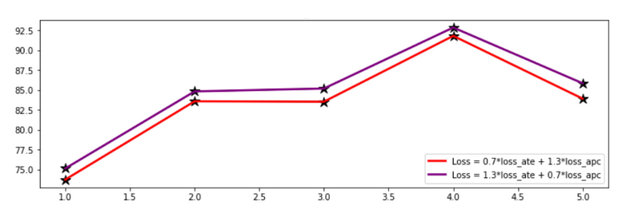
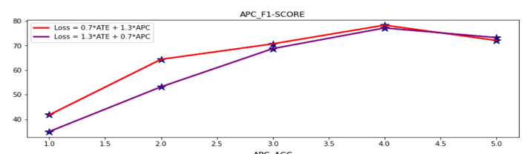
Other Results
Task Attention: Give more gravity to a task
Restaurant dataset: ATE
F1-Score
Fusion, SRD 5
Bert-based-uncased
Restaurant dataset: APC
F1-Score
Fusion, SRD 5
Bert-based-uncased

Slide 28


Summary: LCF-ATEPC
In this presentations we have seen:
Sentiment analysis problem and variants
ABSA: LCF-ATEPC model and structure
Challenges, Datasets and Experiments
Results and Conclusion
More information on Project’s Report!

Slide 29
Questions?
Thanks for your time

